Slide 1



INTEGRATION OF MULTIMODAL NON-INVASIVE SIGNALS
FOR EARLY DETECTION OF COGNITIVE IMPAIRMENT
TEAM SUPERVISOR
TEAM MEMBERS
DR.R.GNANAKUMARI
AP/CSE
SIVA NITHIYA SREE C 727822TUCS223
SUBHALAKSHMI S 727822TUCS237
RISHIPRASANTH G 727823TUCS801

Slide 2

PROJECT DETAILS
Base Paper Title: A MULTI MODALITY FUSION MODEL BASED ON DUAL TASK MEASUREMENT FOR THE AUTOMATIC DETECTION OF EARLY STAGE COGNITIVE IMPAIRMENT
Authors:Shuqiong Wu,Jiaqiang Liu,AkosGod
Published Year :2025
Journal Details:
Journal: IEEE Transaction on Audio, Speech and Language Processing
Volume: 19
Publication Date: 23 JUNE 2025
DOI: 10.1109/TBME.2025.3582269
01

Slide 3
ABSTRACT
  Early detection, cognitive impairment, non-invasive, multimodal signals.
  Facial image analysis (CNN), questionnaire evaluation (Naive Bayes), hybrid approach.
  CNN – detects facial patterns, cognitive decline, image classification.
  Naive Bayes – analyzes responses, predicts impairment, cognitive score (0–10), accurate assessment.
02

Slide 4
INTRODUCTION
Cognitive impairment refers to the decline in memory, thinking, and reasoning skills, which can lead to conditions like dementia.
.
  It combines facial image analysis (CNN) and questionnaire-based evaluation (Naive Bayes) for accurate assessment.
  The fused output generates a cognitive score out of 10, offering a reliable tool for early diagnosis.
03

Slide 5
EXISTING SYSTEM AND DRAWBACK
DRAWBACKS
  Traditional tests (MMSE, MoCA)
  Single modality
  Textual/numerical focus
  Limited accuracy
  Manual evaluation
  Time-consuming
  Single-Modality
  Manual
  Inaccurate
  Time-Consuming
  Limited
04

Slide 6

CHANGES MADE IN THE SYSTEM
  Introduced Multimodal Approach – Combined both facial recognition and questionnaire-based analysis instead of using a single data source.
  Enhanced Data Accuracy – Integrated multiple non-invasive signals to achieve more reliable detection results.
  Improved Output Representation – The final system produces a cognitive score out of 10, reflecting the combined effect of both modalities.
05

Slide 7
PROPOSED SYSTEM
  The system uses a multimodal non-invasive approach combining facial recognition and questionnaire data.
  It analyzes facial features and questionnaire responses to assess cognitive health accurately.
  The fusion of both results generates a final cognitive score out of 10 for early and reliable detection.
06

Slide 8
cy
ALGORITHM
CNN Theorem
Deep Learning
Image Processing
Convolution Layer
Feature Extraction
Pattern Recognition
High Accuracy
Bayes’ Theorem
Probabilistic Classifier
Feature Independence
Posterior Probability
Text / Spam Classification
Simple & Fast
06

Slide 9
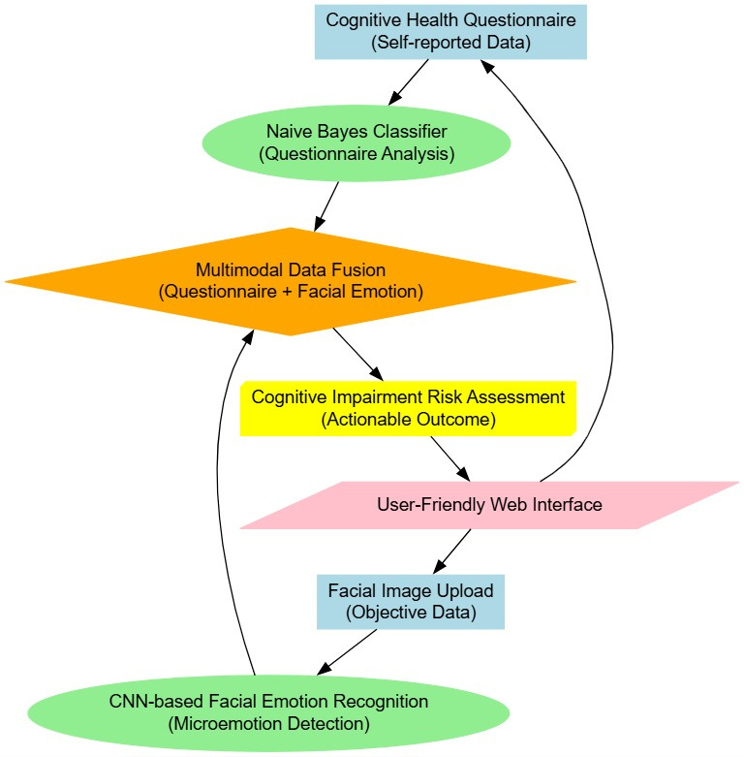
PROPOSED SYSTEM
07

Slide 10
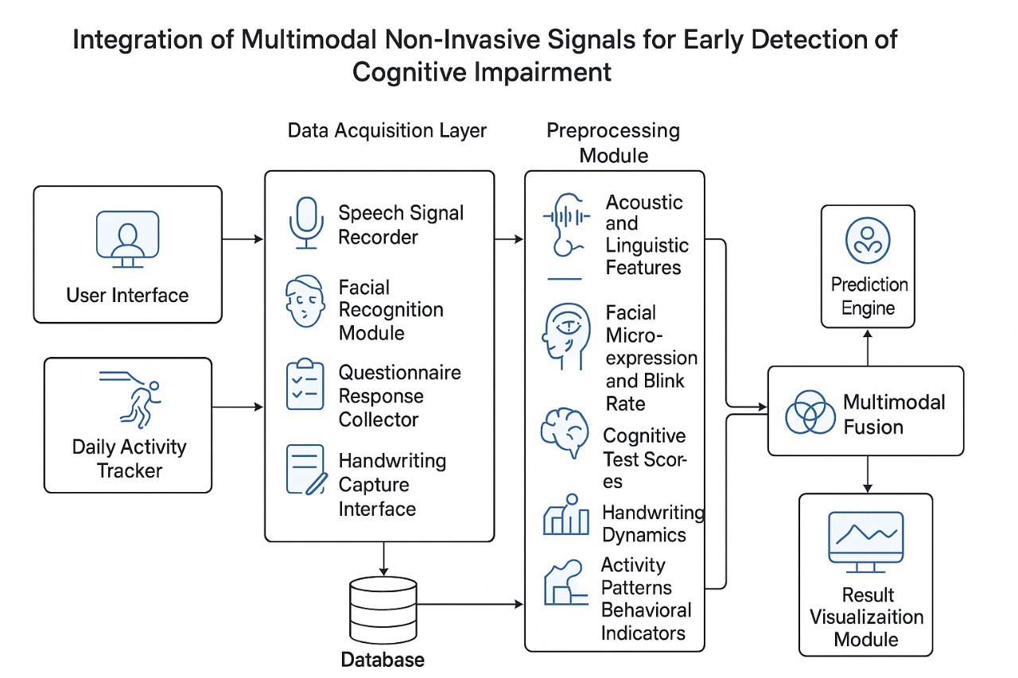
SYSTEM ARCHITECTURE
08

Slide 11
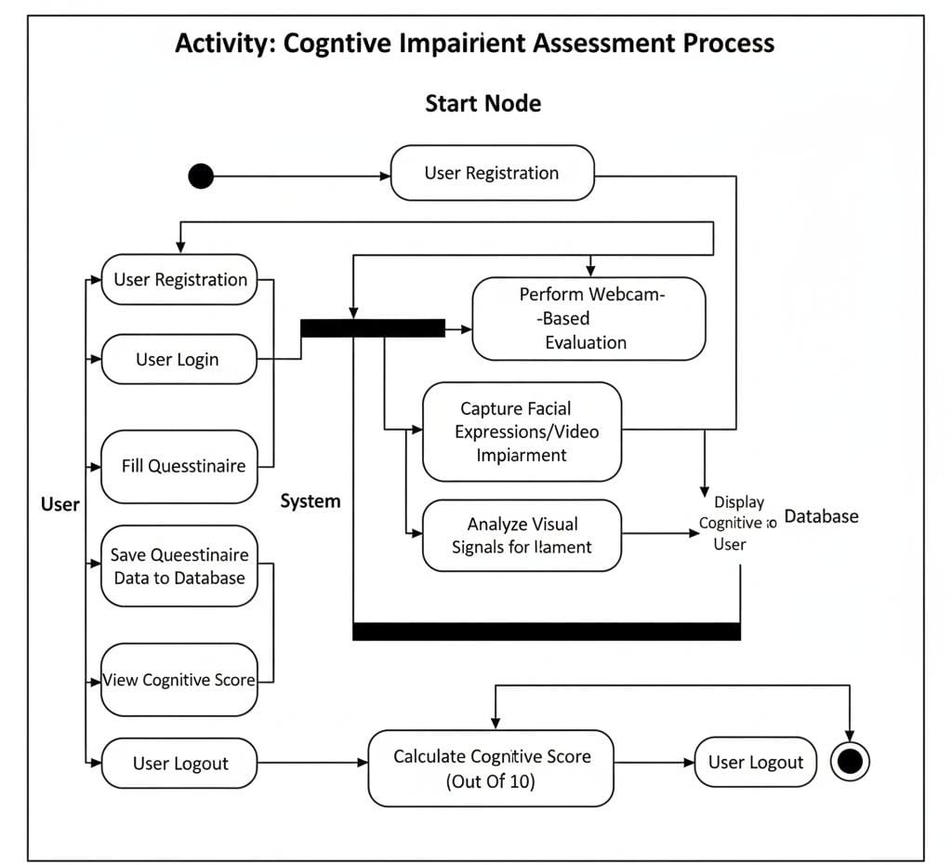
FLOW OF THE SYSTEM
09

Slide 12
FLOW OF THE SYSTEM
  Data Collection Module
  Data Preprocessing Module
  Questionarie based Evaluation
  Facial Recognition and Evaluation
  Fusion of Questionarie and Facial Recognition
  Analytics and Result Module
09

Slide 13
PLATFORMS AND TOOLS
CATEGORY | TOOLS | PURPOSE
Programming Language | Python | For implementing the entire system
Data Handling | NumPy, Pandas | For managing datasets and performing numerical computations
Image Processing | OpenCV, PIL (Python Imaging Library) | For preprocessing and enhancing satellite images
10

Slide 14
PLATFORMS AND TOOLS
  Data Types: Facial images and questionnaire responses related to cognitive assessment.
  Sources: Public repositories, research datasets, and locally collected responses.
  Formats: Images in .jpg/.png, questionnaires in CSV/Excel formats.
  Preprocessing: Images resized and normalized; questionnaire data cleaned, encoded, and fused for cognitive scoring.

Slide 15
CONCLUSION
  In the system by combining facial recognition (CNN) and questionnaire analysis (Naive Bayes), it ensures greater accuracy and reliability than single-method approaches.
  The fused cognitive score (0–10) enables early diagnosis, improving efficiency and practical use in healthcare screening.

Slide 16
THANK YOU..

